Slide 1

Spring Boot OpenTelemetry Setup
Learn how to integrate Spring Boot applications with OpenTelemetry for distributed tracing and observability. This comprehensive guide covers everything from basic setup to monitoring traces in production environments.

Slide 2
What is OpenTelemetry?
Standardized Tools
CNCF Project
Three Pillars
Collection of vendor-agnostic APIs and SDKs for telemetry data capture
Merger of OpenTracing and OpenCensus projects under Cloud Native Computing Foundation
Captures logs, metrics, and traces for comprehensive application observability
OpenTelemetry uses traces and spans to represent request flow across microservices, providing deep insights into application behavior and performance.

Slide 3
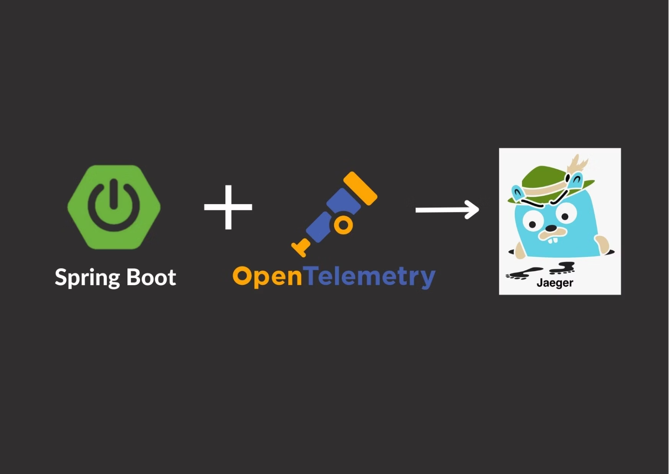
Spring Boot 3 Integration
Micrometer Tracing
Spring Boot 3 supports OpenTelemetry through Micrometer Tracing - a consistent, pluggable, vendor-neutral API that replaces the deprecated Spring Cloud Sleuth framework.
This integration provides automatic instrumentation for HTTP calls, database operations, and more without requiring extensive code changes.

Slide 4
Required Dependencies
To integrate OpenTelemetry with Spring Boot 3, you'll need these essential Maven dependencies:
Spring Boot Starter Web
Micrometer Tracing
Version 3.4.4 - Core web functionality
Version 1.4.4 - Tracing abstraction layer
OpenTelemetry Bridge
OTLP Exporter
Version 1.4.4 - Connects Micrometer to OpenTelemetry
Version 1.39.0 - Exports traces to collectors

Slide 5
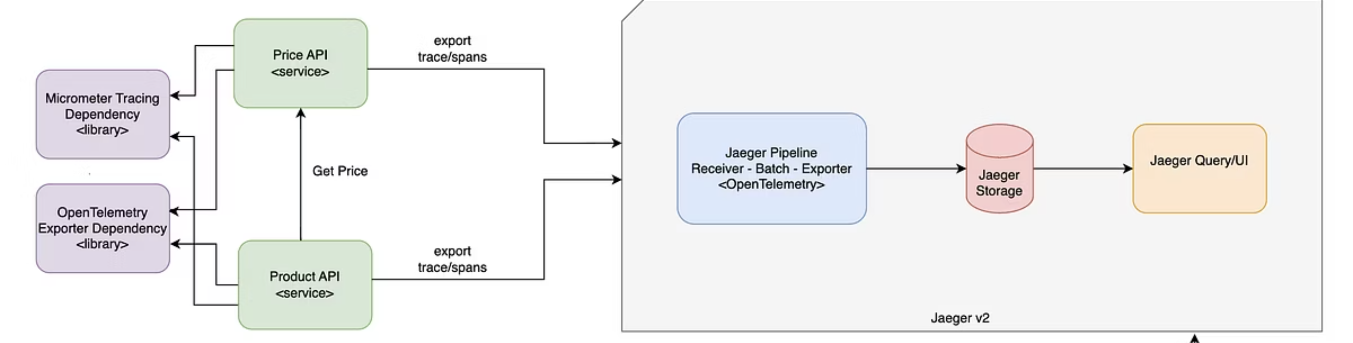
Example Architecture
We'll build two microservices to demonstrate OpenTelemetry integration:
The Product Service calls the Price Service, creating a distributed trace that flows through both applications and gets collected by Jaeger for monitoring and analysis.

Slide 6
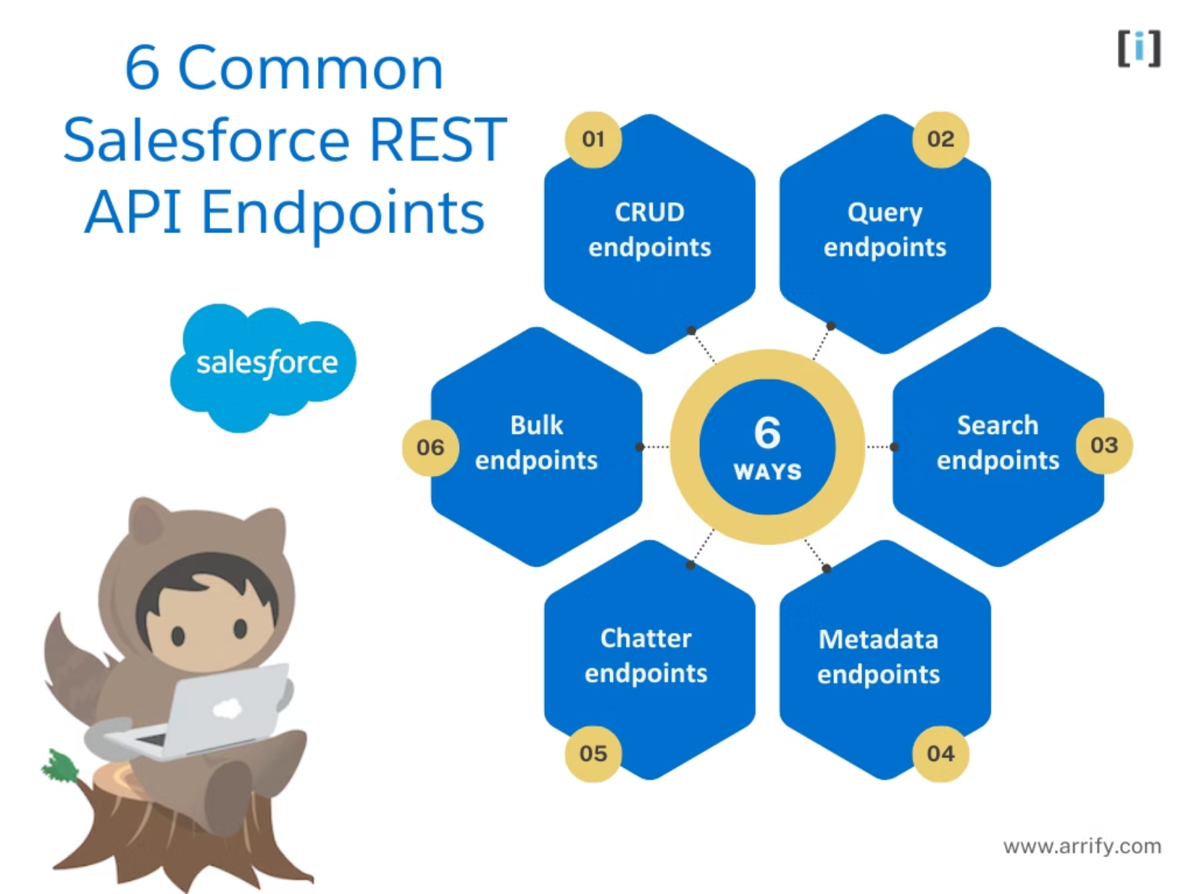
Downstream Service: Price API
Price Controller
The downstream application provides a REST endpoint to return price data for products. It includes proper logging and error handling for missing products.
GET /price/{id} endpoint
Price repository integration
Exception handling for missing products
Structured logging with trace context

Slide 7
Upstream Service: Product API
01
02
Receive Request
Fetch Product
Product controller receives GET request for product details
Repository retrieves product information from internal storage
03
04
Call Price Service
Combine & Return
RestTemplate makes HTTP call to downstream price service
Merge product and price data, return complete product details

Slide 8

Spring Configuration
Configure OpenTelemetry tracing in your application.yml file:
management: tracing: sampling: probability: '1.0' otlp: tracing: endpoint: http://collector:4318/v1/traces
The sampling probability of 1.0 means all spans will be exported. In production, consider lower values like 0.1 (10%) to reduce overhead.

Slide 9
Docker Configuration
Application Dockerfile
Docker Compose Services
Product Service (port 8080)
FROM openjdk:17-alpineCOPY target/app.jar app.jarEXPOSE 8080ENTRYPOINT ["java","-jar","/app.jar"]
Price Service (port 8081)
Jaeger Collector (ports 4318, 16686)
The Jaeger v2 all-in-one image includes built-in OpenTelemetry support, eliminating the need for separate collector services.

Slide 10



Running the Application
Build Images
Start Services
Verify Status
Docker builds application containers from Dockerfiles
Docker Compose launches all services simultaneously
Check container health and port mappings
Use docker-compose up to start all services, then verify with docker container ls to ensure proper startup.

Slide 11
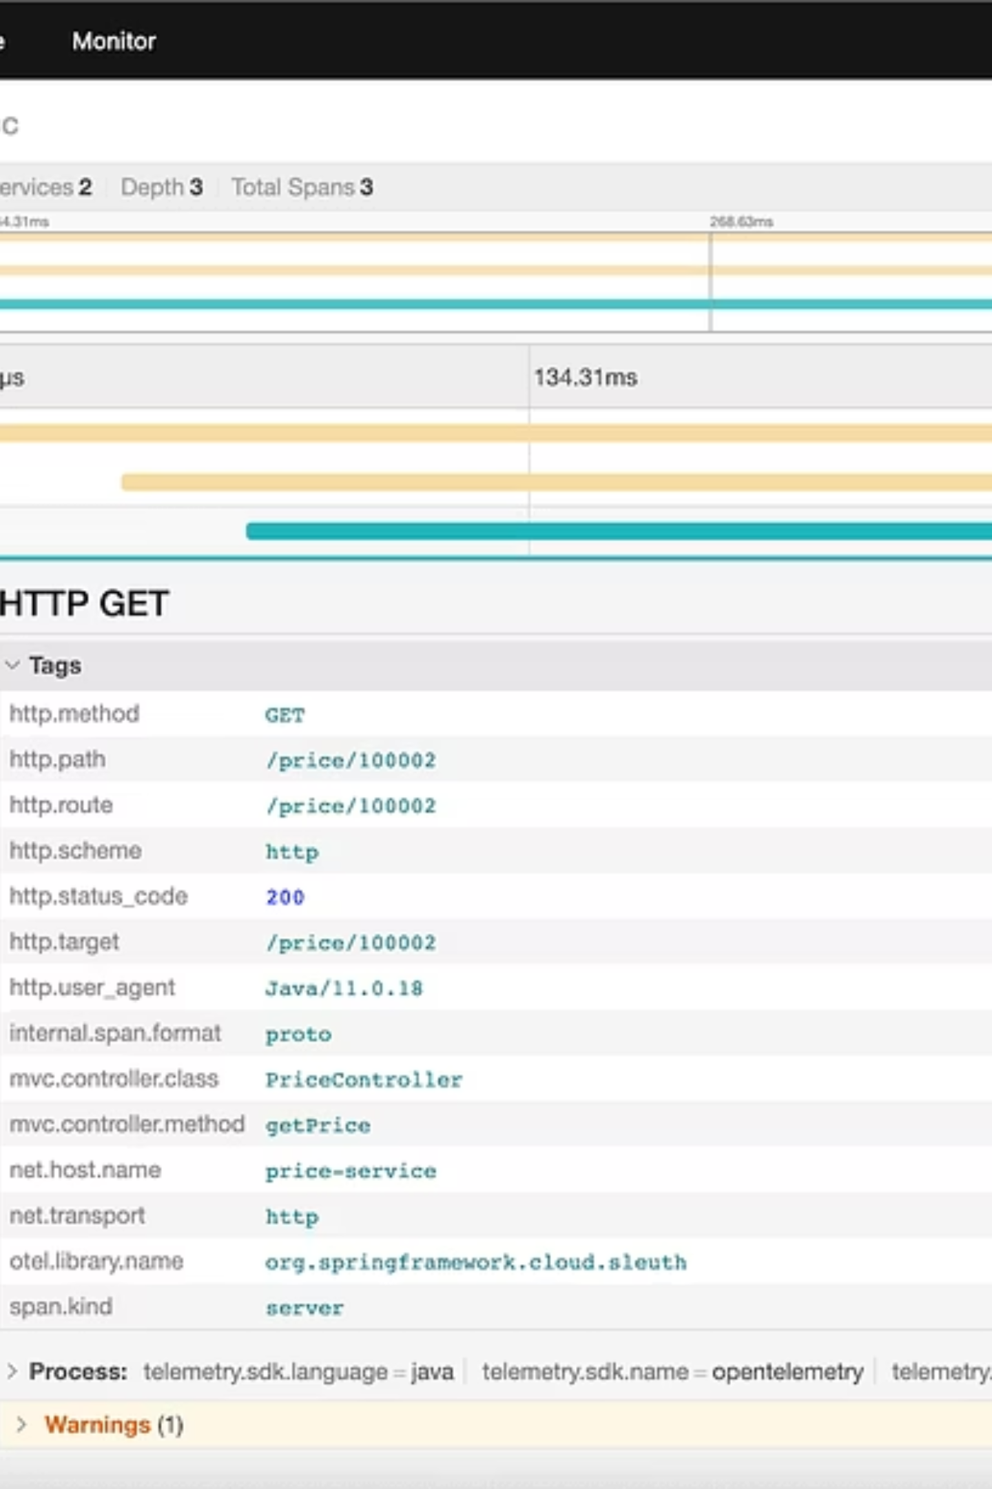



Successful Request Tracing
When calling the Product endpoint successfully, OpenTelemetry automatically:
Trace ID Generation
Creates unique trace identifier that flows through all services
Span Creation
Records timing and metadata for each operation
Context Propagation
Passes trace context via HTTP headers between services

Slide 12
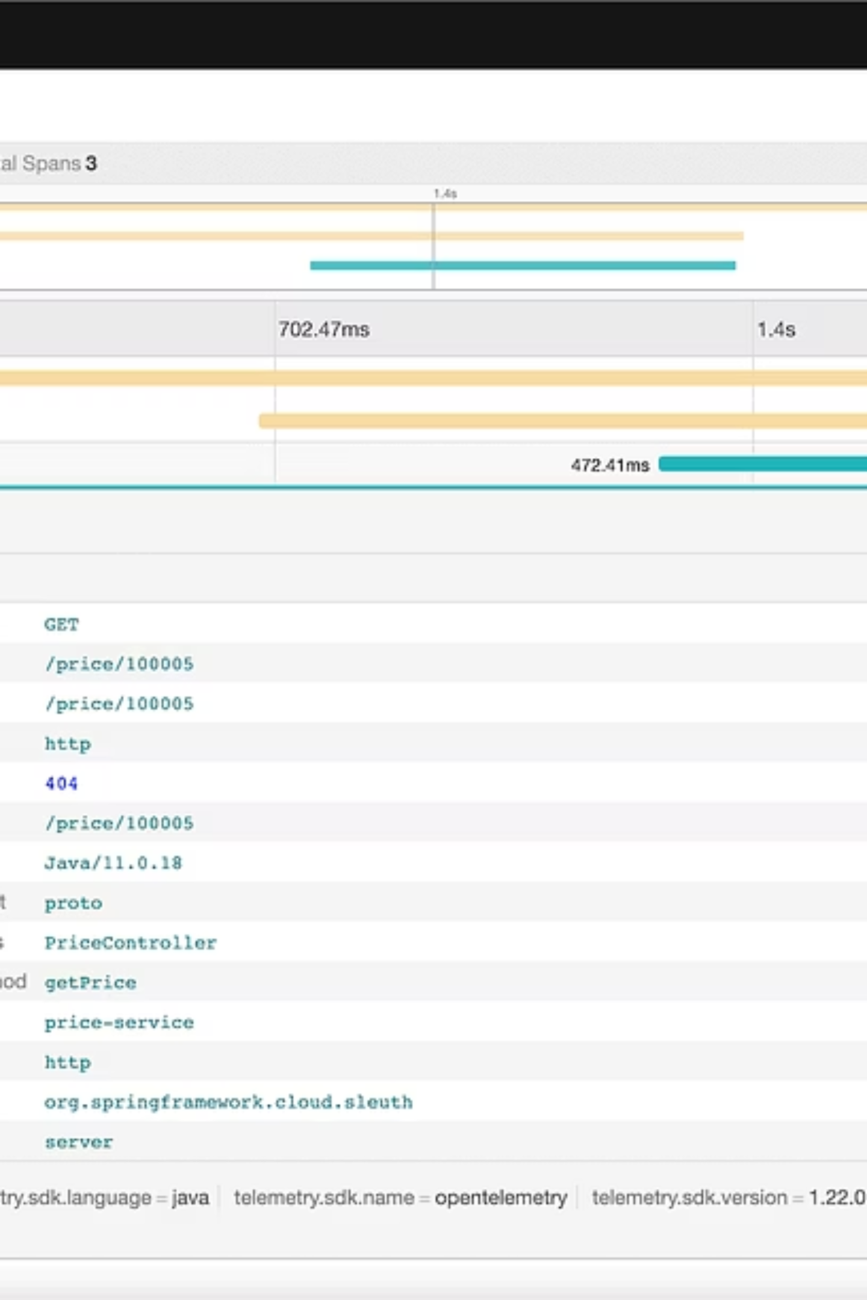
Error Tracing & Analysis
When requests fail, OpenTelemetry captures detailed error information:
Error Propagation
Root Cause Analysis
Exceptions are captured and marked in spans, making it easy to identify where failures occur in the request chain.
The Jaeger UI shows the exact service and operation where errors originated, accelerating debugging.

Slide 13



Jaeger UI Monitoring
Real-time Traces
Trace Search
Performance Analysis
Monitor request flows as they happen across your microservices
Query historical traces by service, operation, or custom tags
Analyze latency patterns and identify bottlenecks
Access the Jaeger UI at http://localhost:16686 to visualize traces and analyze application performance.

Slide 14
Production Considerations
Sampling Strategy
Separate Components
Security & Compliance
Use probability-based sampling (e.g., 0.1 for 10%) to balance observability with performance overhead in high-traffic environments.
Deploy OpenTelemetry collector, storage, and UI services separately for better scalability and separation of concerns.
Implement proper authentication, data retention policies, and ensure sensitive data is not captured in traces.

Slide 15
Key Takeaways
Observability Made Simple
OpenTelemetry with Spring Boot 3 provides standardized, vendor-neutral observability for microservices. The Micrometer integration offers automatic instrumentation with minimal configuration.
Zero-Code Instrumentation
Distributed Request Tracking
Production-Ready Monitoring
Automatic trace generation for HTTP calls, database operations, and more
Follow requests across multiple services with unified trace IDs
Real-time error detection and performance analysis capabilities
Start implementing OpenTelemetry today to gain deep insights into your distributed systems and improve application reliability.

